Slide 1
Census Income Prediction
A Machine Learning Approach

Slide 2
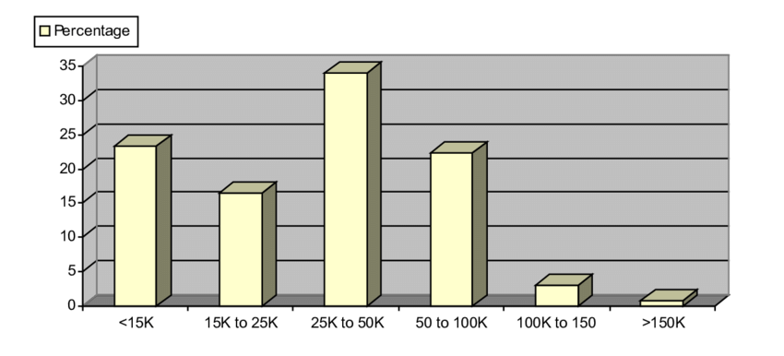
Introduction to Problem Statement
Predicting income levels based on demographic and socioeconomic factors is complex.
Binary Classification: Identify if an individual’s income is above $50,000 or not.
Motivation: Develop multiple machine learning models to determine the best approach for accurate predictions.

Slide 3
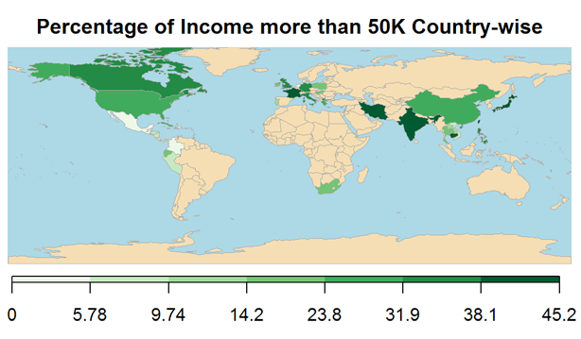
Why This Problem Matters?
Practical applications in policy-making, targeted marketing, and financial planning. (E.g. targeted financial services using income predictions)
Comparative analysis helps in understanding the strengths and weaknesses of the algorithm in a real-world scenario.
Goal: Find the most effective methodology to predict income levels accurately and efficiently.

Slide 4
Literature Review
Paper 1
Paper 2
Adult Income Classification using Machine Learning Techniques
Objective: Applied different machine learning algorithms to the adult income dataset.
Key Findings: Logistic Regression and Decision Trees showed good performance, with Random Forest outperforming them.
Relevance: Provides baseline models and insights for comparison in this project.
Link: IEEE Xplore - Adult Income Classification
A Comparative Analysis of Machine Learning Algorithms for Classification Purpose
Objective: Analyzed various classification algorithms across multiple domains.
Key Findings: Identified trade-offs between accuracy and interpretability (e.g. Neural Networks vs. Decision Trees).
Relevance: Informs our model selection strategy and highlights the need for balancing accuracy and interpretability.
Link: IEEE Xplore - Comparative Analysis

Slide 5

Dataset Description
Overview of the Dataset
Visualization of Key Attributes
Preprocessing Details

Slide 6
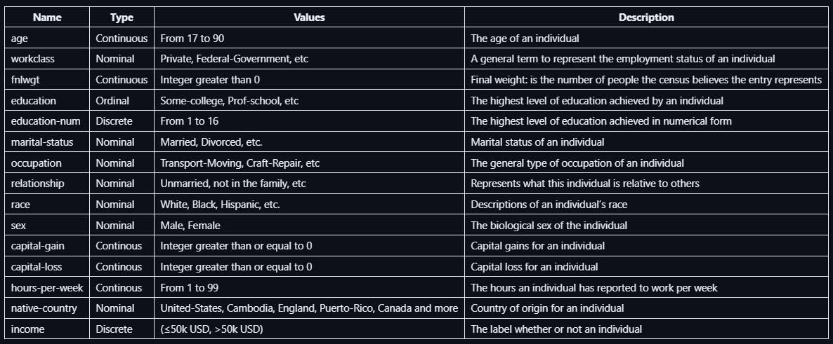
Overview of the Dataset
Dataset Name: Census Income Dataset
Target Variable: Income (Binary Classification: >$50K or <= $50K)
Attributes: age, work-class, education, marital-status, occupation, relationship, race, sex, hours-per-week, capital-gain, capital-loss, native-country, education-num, fnlwgt (final weight) .

Slide 7
Visualization of Key Attributes
Bar Plot: Income, Avg of hours per week, Avg of age for sex
Heatmap: Income vs Education
Histogram: Numerical Features
Box and Violin Plot: Box plot for numerical features and Violin plot for categorical features
Pair Plot: All features

Slide 8
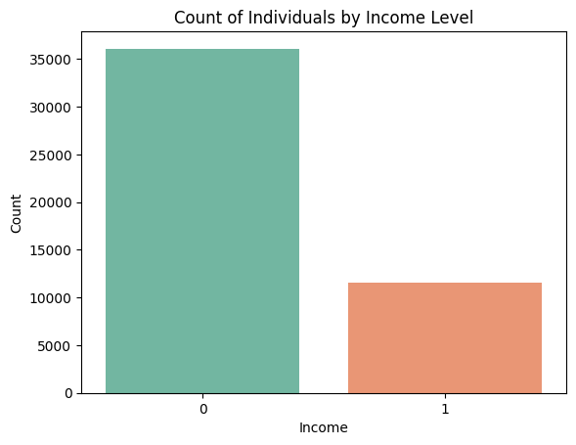
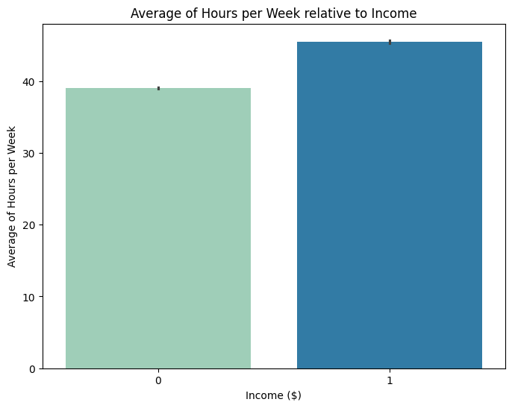
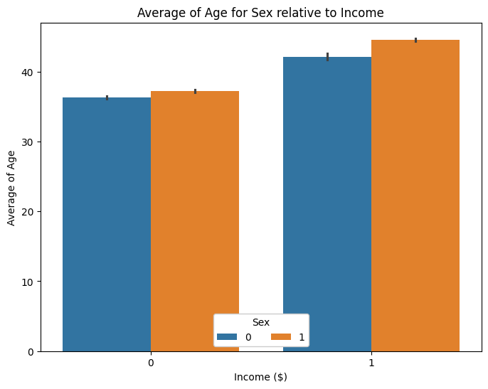
Bar Plots
Income Distribution: Bar plot showing the number of people in different income classes (i.e. > $50K or <= $50K).
Average of Hours per Week vs Income: Bar plot depicting relationship of income growing directly with the average of work hours per week.
Average of Age for Sex vs Income: Bar plot showing that the people with income 50K have a higher average age. With male average age being greater in both cases.

Slide 9
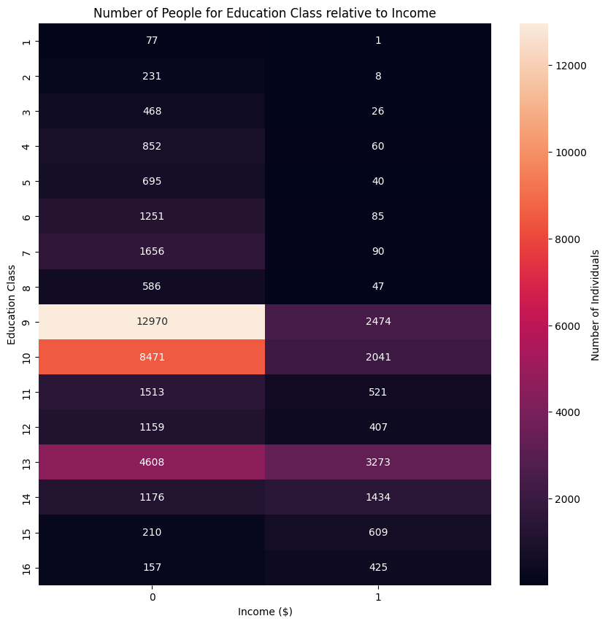
Heatmap
The Income-Education heatmap suggests a strong relationship between education and income.
Notably, the 9th and 10th education levels have the highest counts overall lower income (≤$50k).
While level 13 shows significant representation in both income categories.

Slide 10
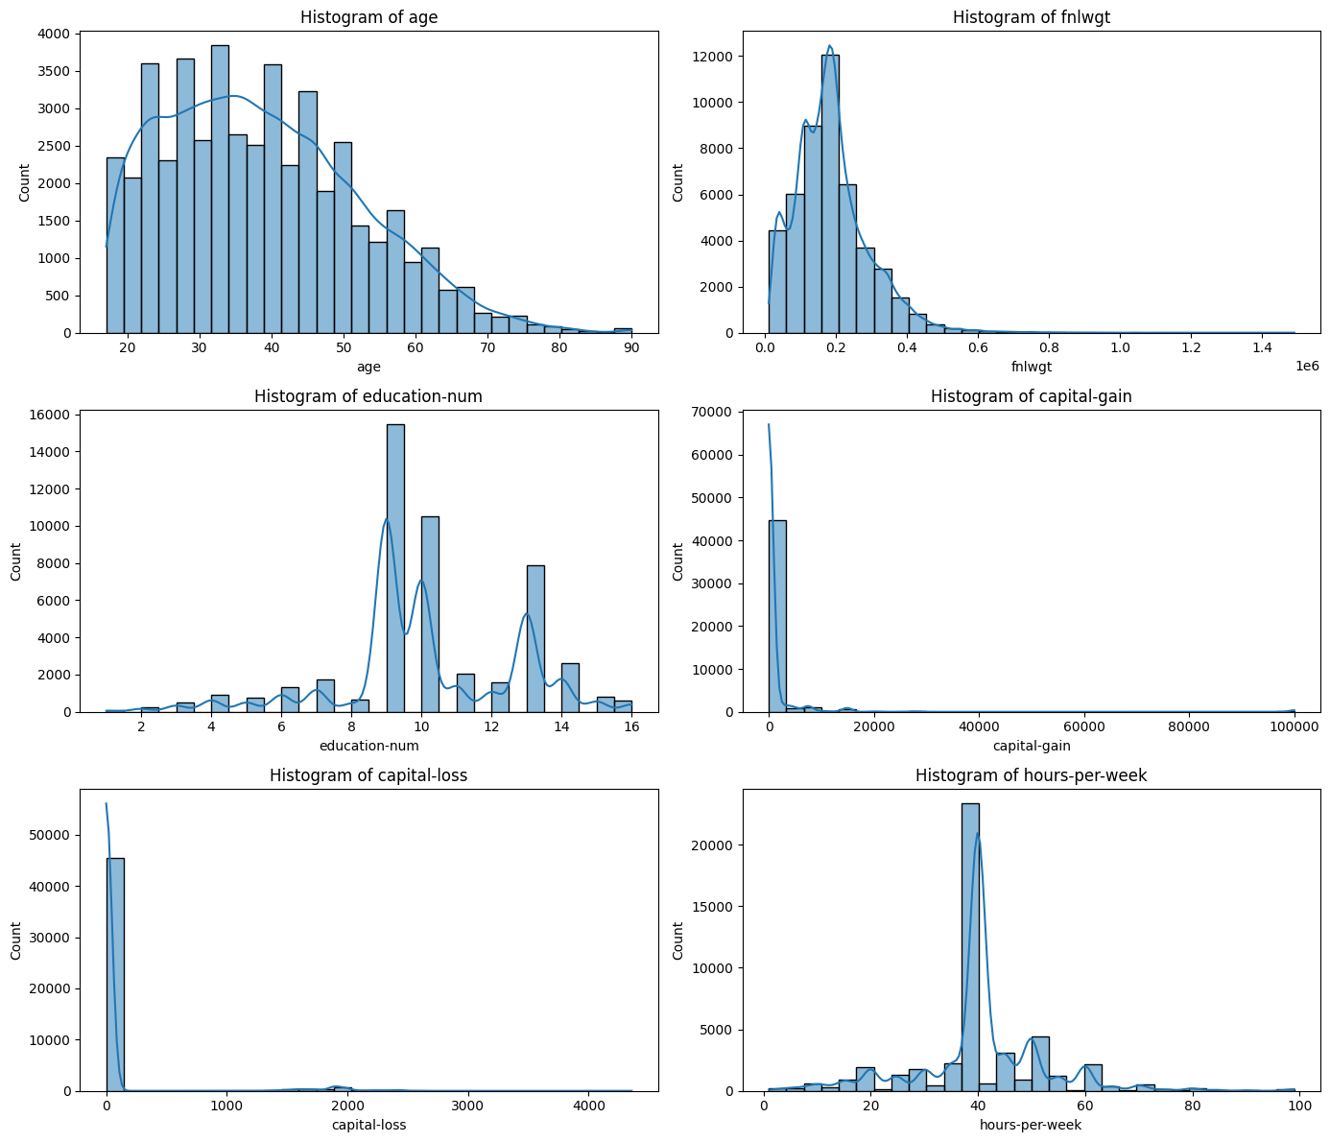
Histogram
Histograms of numerical features:
age: The distribution is right-skewed with most people between 20 and 50 years old.
fnlwgt (final weight): Strongly right-skewed, with the majority of values concentrated below 0.2 million.
education-num: Bimodal distribution, peaking at 9 and 10 years of education.
capital-gain: Highly right-skewed, with most people having zero capital gains.
capital-loss: Most people have zero capital losses, with very few reporting large losses.
hours-per-week: Peaks at around 40 hours, with a concentration of people working between 35-45 hours.

Slide 11
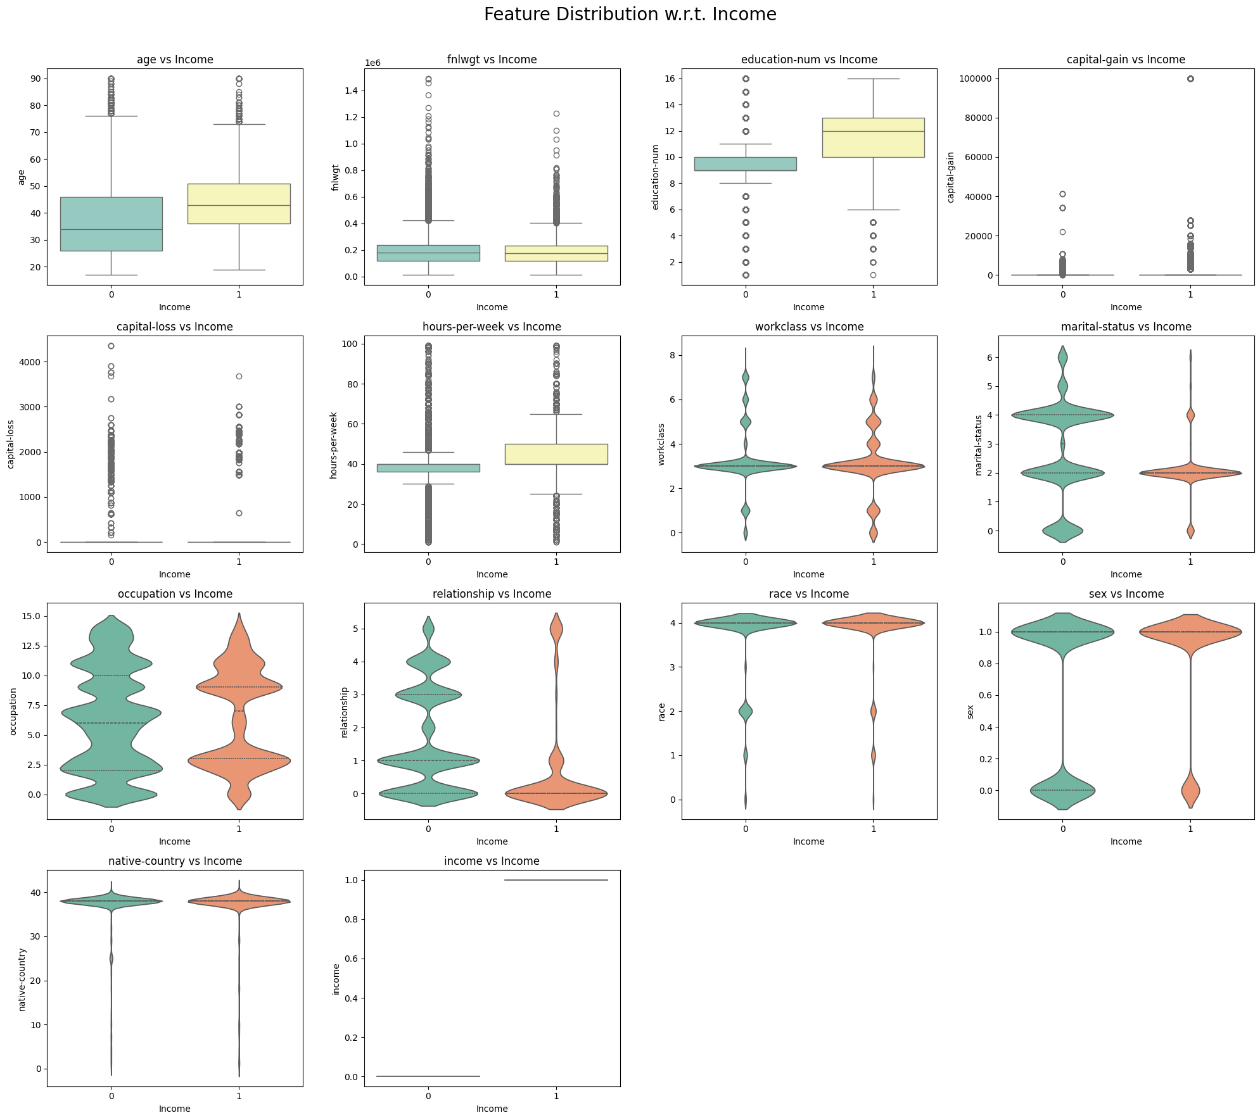
Box and Violin Plot
Key observations w.r.t income:
capital-gain: Strongly correlated with high income, with significant gains in individuals earning >50K.
capital-loss: Higher capital losses also occur more frequently in the >50K income group.
marital-status: Married individuals tend to have higher income, indicating marital status may influence earnings.
occupation: Certain occupations are more prevalent among higher-income individuals.
relationship: Married individuals and specific relationship types are more associated with higher income.

Slide 12
Preprocessing Details
Label Modification:
Fetched Income labels = {'<=50K.’, '<=50K', '>50K.’, '>50K’}
Final modified Income labels = {'<=50K', '>50K’}
Dropped Duplicate Features:
`education` column was duplicate of `education-num`, so we dropped it.
Handling Missing Data:
Dropped all rows with missing value (around 1200 data points from 48k data points).
Encoding Categorical Features:
Applied Label encoding for features like sex, occupation, work-class, etc.
Normalizing Numerical Features:
Applied standard scaling technique to continuous numerical features.

Slide 13

Methodology
Train-Test Split
Model Selection and Training
Bias and Variance
Evaluation Metrics

Slide 14
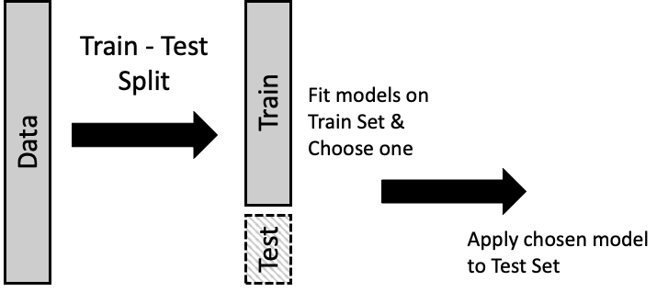
Train-Test Split
Split the data in 80:20 ratio.
80% - Training Set to train the model
20% - Testing set to measure model’s generalization
This split helps avoid overfitting and ensures the model is robust when facing new data.

Slide 15
Model Selection and Training
Models:
Logistic Regression
Decision Trees
Random Forest
Random Oversampling: To address the class imbalance in the dataset with individuals earning more than $50k representing 75% of the data, Random Oversampling method was used.

Slide 16
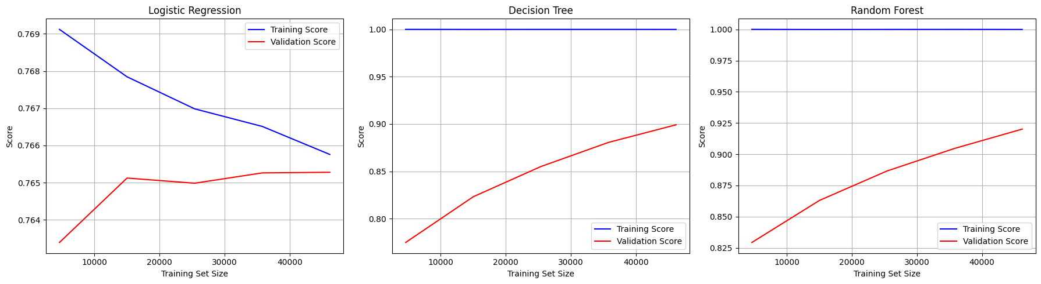
Bias and Variance
Random Forest shows the best overall performance
Decision Tree and Random Forest both suffer from overfitting but show promising validation improvements
Logistic Regression shows underfitting, suggesting it might be too simple for this problem

Slide 17
Evaluation Metrics
• Accuracy: Random Forest achieved the highest accuracy at 93%, outperforming both Logistic Regression at 76% and Decision Trees at 91%.
• Precision and Recall: Random Forest again performed best, striking a good balance between precision (90%) and recall (97%).
• F1-Score: Random Forest had the highest F1-Score at 0.93.
• AUC-ROC Curve: Random Forest achieved the highest AUC (= 0.99), indicating strong predictive capabilities across varying thresholds.

Slide 18
Conclusion
Preliminary Conclusion: Random Forest seems to be a strong candidate for further evaluation.
Next Steps:
Feature Selection to drop unnecessary features and simplify model.
Hyperparameter tuning to enhance performance.
SVMs: Exploring more complex models that may offer better accuracy

Slide 19
Timeline
Completed Task:
Data collection and preprocessing.
Exploratory Data Analysis (EDA)
Initial Model Selection and training
Future Timeline:
Week 7-8: Hyperparameter tuning and advanced model comparison.
Week 9-10: Final evaluation and report preparation.
Week 11-12: Presentation and Submission.

Slide 20
Individual Team Member’s Contribution
• Sameer Singh Godara (2022439): Visualization, report writing, and presentation preparation.
• Sanyam Barwar (2022447): Preprocessing, Exploratory Data Analysis (EDA), project management and finalization.
• Sanyam Garg (2022448): Data collection, feature engineering, and model comparison.
• Vivan Rangra (2022581): Model selection, initial training, and evaluation of traditional ML models.

